Slide 1



Air uality Index
Visualization
Mentor Name:Bhargav Sai Reddy Coordinator Name: Anantha Lakshmi

Slide 2
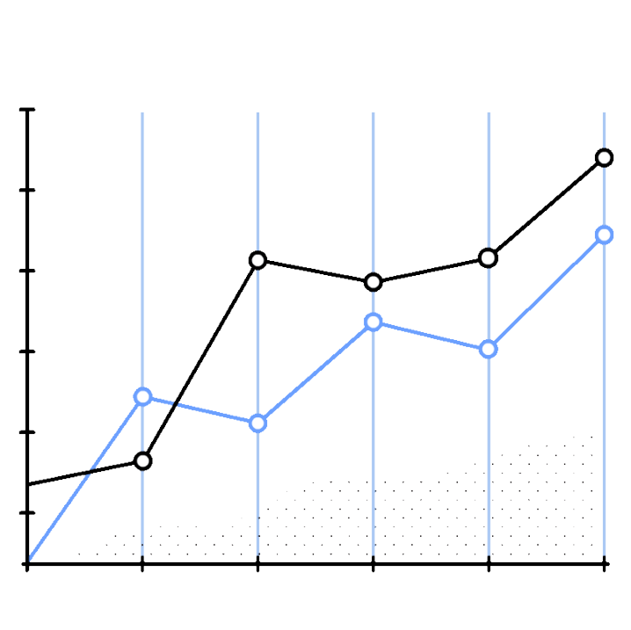
Introduction
PROJECT GOAL: REAL-TIME, INTERACTIVE VISUALIZATIONS OF AIR QUALITY METRICS (AQI, CO, PM2.5, PM10, NO2, OZONE).
KEY FEATURES:
TRACK AND ANALYZE AIR POLLUTION DATA. CHATBOT INTEGRATION FOR EASY INFORMATION.
ACCESS TO
PURPOSE: RAISE AWARENESS AND SUPPORT INFORMED DECISIONS ON AIR QUALITY.

Slide 3


PROBLEM STATEMENT
PROBLEM: AIR POLLUTION IS A RISING ISSUE, ESPECIALLY IN URBAN AREAS, IMPACTING HEALTH AND THE ENVIRONMENT.
CHALLENGE: LIMITED ACCESS TO REAL-TIME, ACCURATE AIR QUALITY DATA IN AN UNDERSTANDABLE FORMAT.
AN INTERACTIVE PLATFORM PROVIDING REAL-TIME AIR QUALITY METRICS (AQI, PM2.5, PM10, NO2) FOR THE PUBLIC, RESEARCHERS, AND POLICYMAKERS.

Slide 4

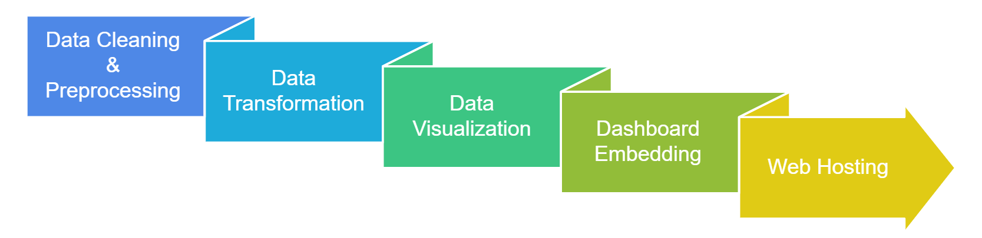





TECHNOLOGY STACKS
The project involves cleaning and transforming raw data for accurate analysis and visualization. Interactive charts and graphs are embedded into a user-friendly dashboard. The platform is web- hosted for easy access, and Power BI integration enhances analytics and visualizations.

Slide 5

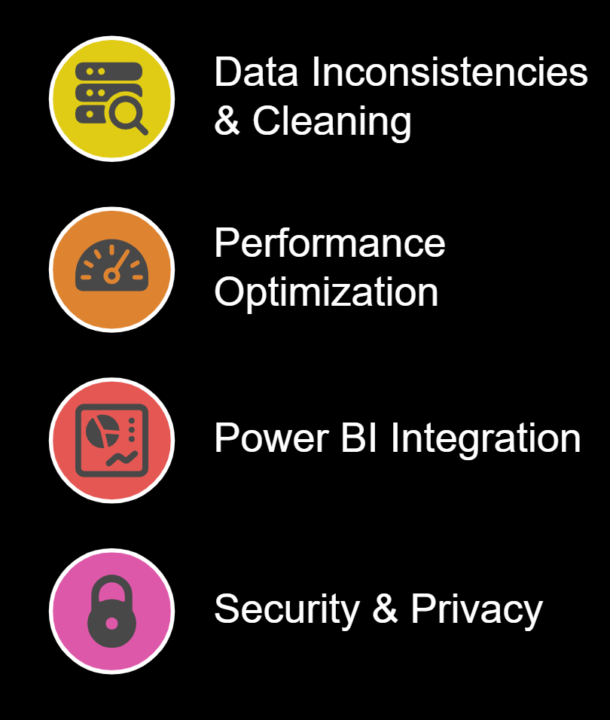



Challenges Faced
Data Inconsistencies & Cleaning
Resolved incomplete data and applied preprocessing for accuracy.
Performance Optimization
Enhanced data loading and system responsiveness.
Power BI Integration
Configured embedding and access permissions.
Security & Privacy
Ensured smooth real-time data fetching and communication.

Slide 6

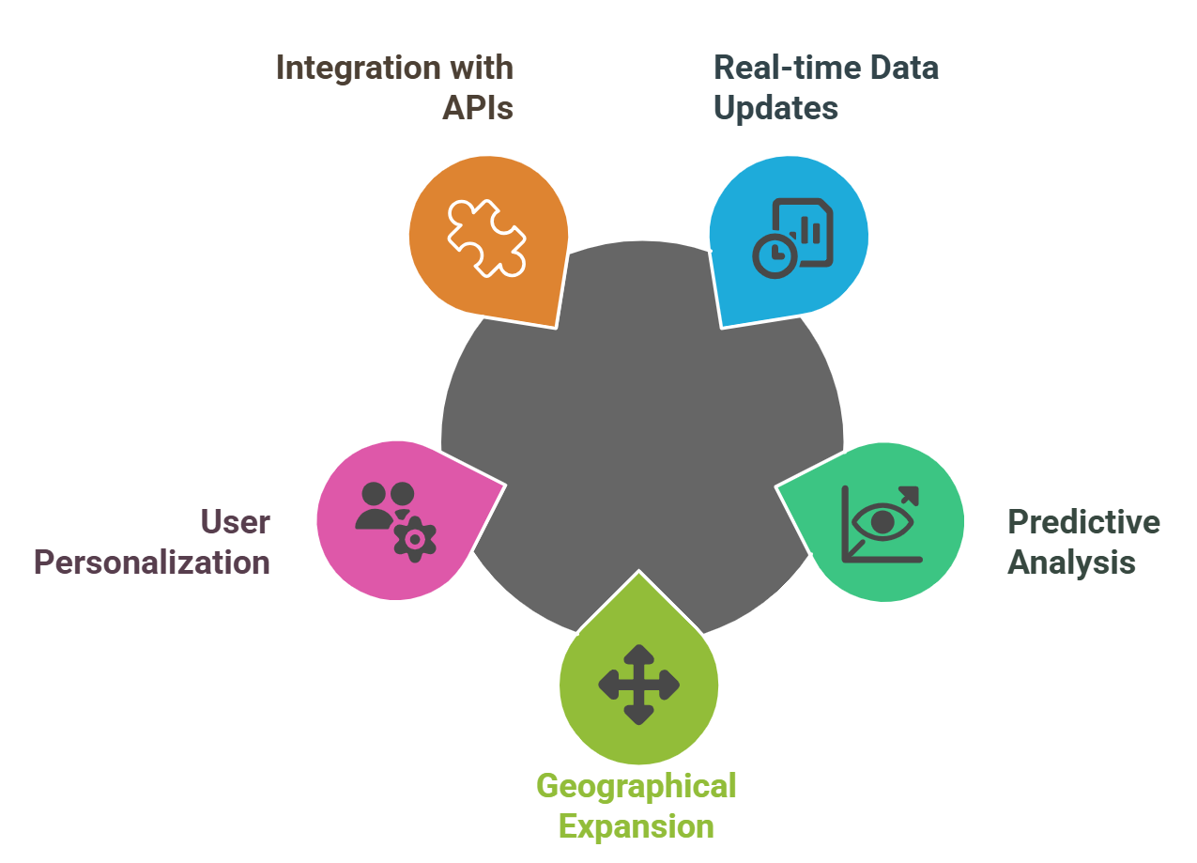
Integration with external APIs
FUTURE ENHANCEMENTS
Incorporate additional data sources for enriched air quality insights.
User personalization
Allow users to customize data views and alerts based on preferences.
Geographical expansion
Extend coverage to more regions for a broader data set.
Predictive analysis
Implement forecasting models to predict air quality trends.
Real-time data updates
Continuously refresh air quality data for accurate, up-to-date information.

Slide 7








CONCLUSION
50
THE AIR QUALITY DASHBOARD EFFECTIVELY VISUALIZES REAL-TIME AIR QUALITY METRICS USING PYTHON, STREAMLIT, AND POWER BI.
CHATBOT INTEGRATION ENHANCES USER INTERACTION AND SIMPLIFIES DATA ACCESS.
40
30
FUTURE ENHANCEMENTS INCLUDE MACHINE LEARNING FOR PREDICTIONS, DATA SOURCE EXPANSION, AND UI IMPROVEMENTS.
20
KEY LESSONS EMPHASIZE EFFICIENT DATA HANDLING AND A USER-FOCUSED DESIGN FOR BETTER ADOPTION AND ENGAGEMENT.
10
0
SO2
NO2
AQI
RSPM
SPM

Slide 8
Thank You

